Slide 1
Sentiment Analysis on CNN News
Pengru Lin, Mauro Wang, Lyushen Song, Leonardo Trucios, Ashley Mercado
Notes:
Good morning everyone, this is group three. Today we will walk you guys through the sentiment analysis on CNN News.

Slide 2
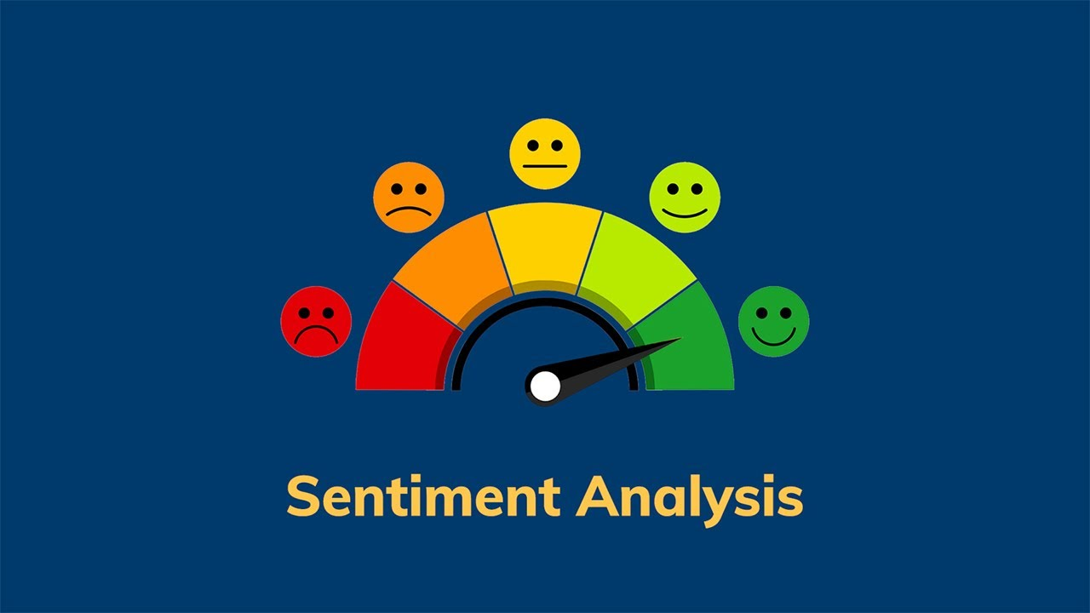
Agenda
Problem Definition
Dataset
Methodology
Results
Challenges
Potential business applications
Notes:
Clearly define the problem and its significance. Share the challenges faced and how they were addressed, including data and methodological adjustments.
Use clear visuals to support your findings. Ensure all graphics are relevant and legible.

Slide 3
Problem Definition
01
02
03
Objective
Scope
Importance
Notes:
Objective: Our goal is to analyze the dataset to develop Natural Language Processing model to better understand the sentiment of the those news, and to further provide insightful analysis on how audience perceive the news.
Scope: Analyze Sentiments into three categories: Positive, Neutral, Negative.
Importance to CNN: Increase user engagement and higher quality content strategy.

Slide 4



Dataset
author
date_published
Zip
2011 - 2022
10
part_of
Type
article_section
Employee Name
Primary City
url
Department Name
State
112k
Rows
23
Columns
38,000
headline
Title
Country
HTML Websites
Web Crawling
Data
description
Income Components
World Region
keywords
Year
alt_headline
Zip Code
article text

Slide 5
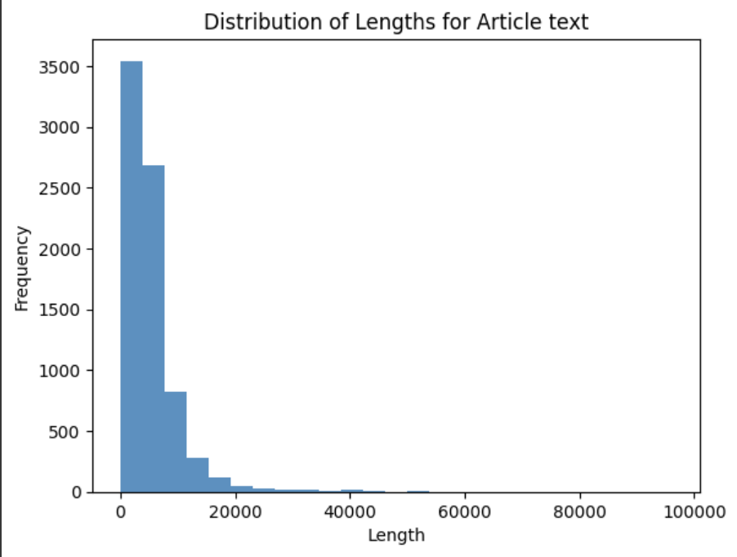
Dataset
Zip
Type
Employee Name
Primary City
Department Name
State
112k
Rows
23
Columns
Title
Country
Income Components
World Region
Year
Zip Code
Notes:
Distribution is highly skewed, with most of the article between 0-10k words.

Slide 6




Methodology
EDA & Cleaning
Preprocessing
Modeling for Sentiment Analysis
Market Basket Analysis
Irrelevant columns
Missing Values
Undersampling
Tokenization
BoW and TF-IDF
3 possible outcomes: negative, neutral and positive
Supervised ML: NLTK Sentiment Analyzer
Unsupervised ML: Word2Vec
TextBlob
Transaction Encoder
Apriori Method
Rules Association

Slide 7
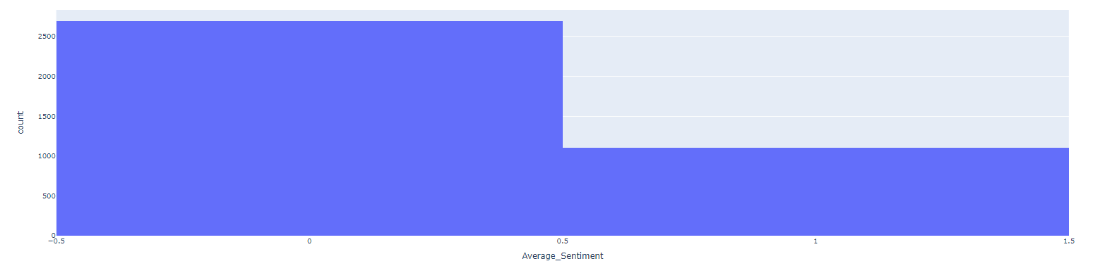
Results (I/IV)
Preliminary Results

Slide 8
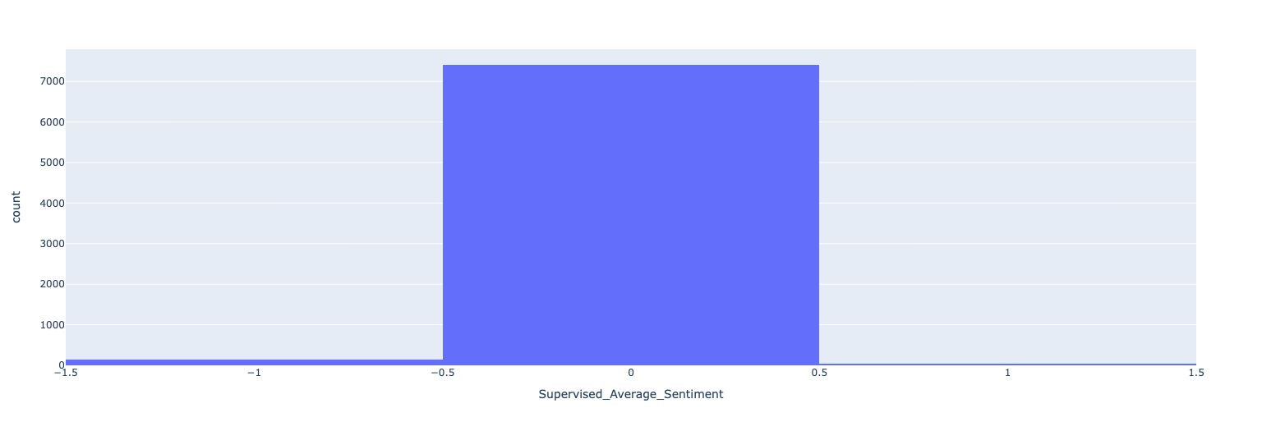
Results (II/IV)
SentimentIntensityAnalyzer

Slide 9
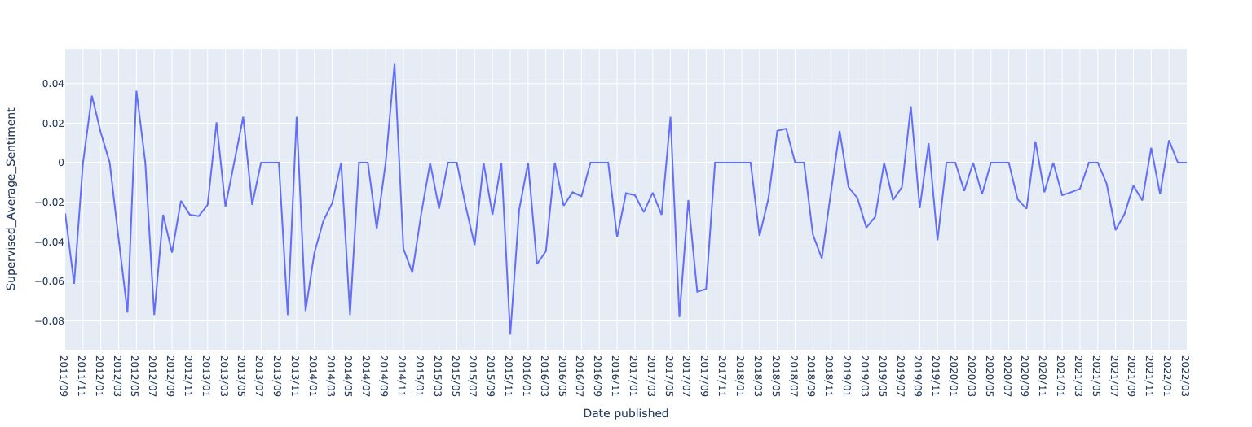
Results (III/IV)
Sentiment Trends Over Time

Slide 10
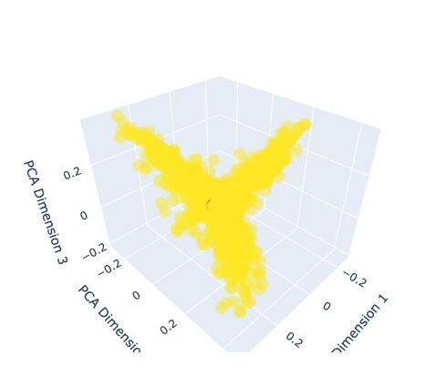
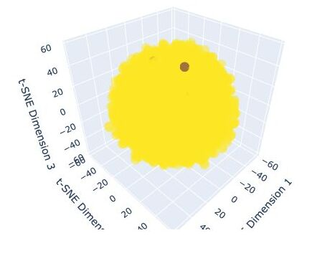
Results (IV/IV)
PCA VS t-SNE

Slide 11

Challenges
Cleaning the data due to web crawling
‘Author’ column : ‘Anonymous’
9 missing values in the 'Article text' column, 0.02% of the dataset
Undersampling 20% of the data.
Notes:
BOW, TF IDF , REMOVED OUTLIERS CLEANING DATA

Slide 12



Business Applications and Future Implementations
RESEARCH
ANALYZE
DEPLOY
Notes:
optimizing content delivery.
help cnn to maintain factual and neutral reporting, fostering trust with their audience
Political news enable voters to understand if news show unbiased sentiment.

Slide 13
Thank you

